Slide 1
Convolutional neural networks(CNN) – not that CNN ☺
Short introduction to what convolutional neural networks are
How cNN work
Patterns when designing CNNS
KNOWN CNN ARCHITECTURES( ALEXNET, VGGNet, googlenet, resnet)
Some code and some fun uses ☺

Slide 2
CNNs work in the same way as regular ANN, each layer of a CNN finds succesively complex features
They stack neurons in hidden layers
They have weights that are randomly initiated and learned durin training
They still apply an activation function
They still calculate the error and then backpropagte the error to update the weights
The main difference is that they use ”special” layers/modules called conolution layers instead of fully connected layers

Slide 3


Slide 4
Why are convolutions better that fully connected networks?
MLPs have to flatten the image to be able to process it(loos of spatial features), while CNNs can treat raw images as the input data
MLPs have fully connected layers that yield a very high computational cost, while CNN are locally connected(the nodes are connected to a small subset of the previous layers node)
An image of 1000 X 1000 and 1000 neurons/hidden layer a MLP would do 1 bilion operations just for the first layer!

Slide 5
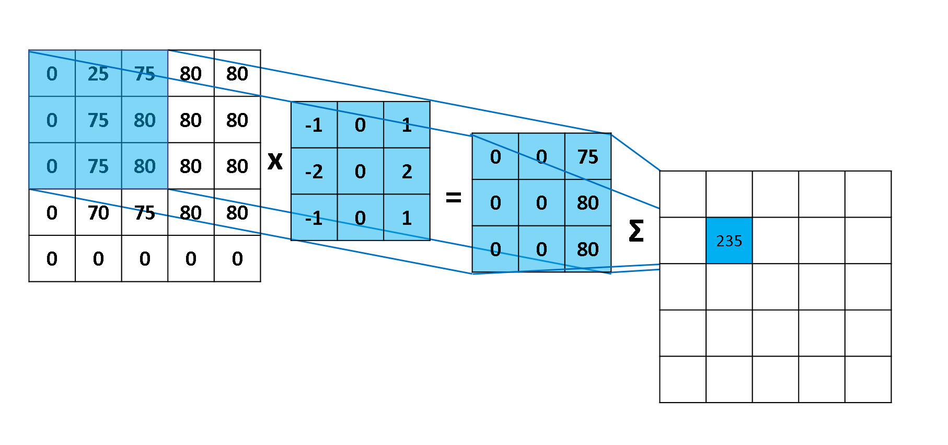
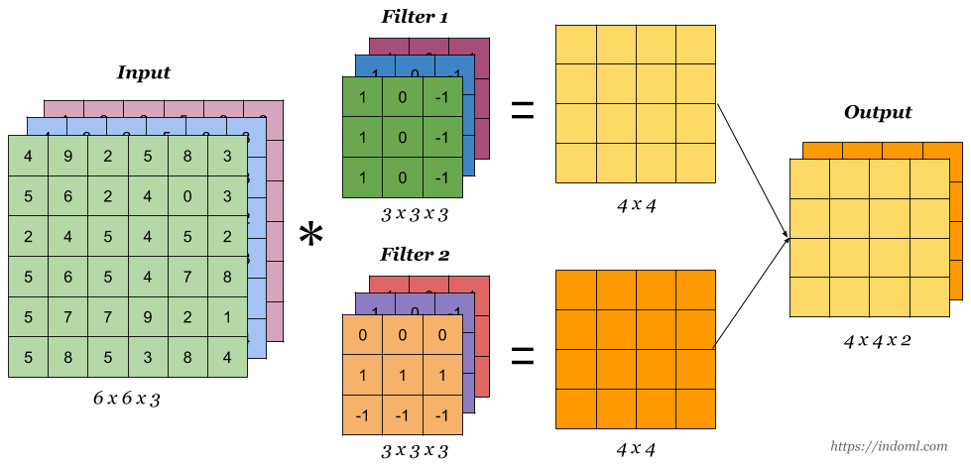
Kernels to the rescue(a fancy name for 2D matrix, also known as filters)
In CNNs the kernel contain the weights that the network needs to learn.

Slide 6
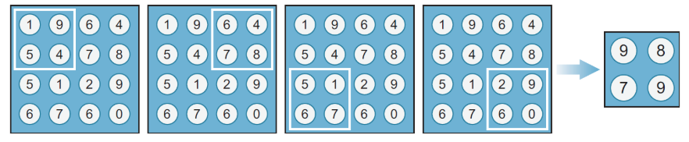
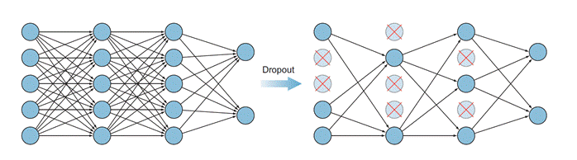
Pooling(subsampling)
DROPOUT

Slide 7

Putting it all togheter

Slide 8
Patterns (because everyone loves them)
CNNs have two parts: a feature extraction part which consists of a series of convolutional layers and a classification part that consists of a series of fully connected layers. Use RELU for hidden layers and SOFTMAX for classification layer
As the input (image) passes through the network depth is increasing and dimension is decreasing. This translates to that network is learning more complex features as the image passes through the network
Last part of the network are fully connected layers that decresease in size

Slide 9
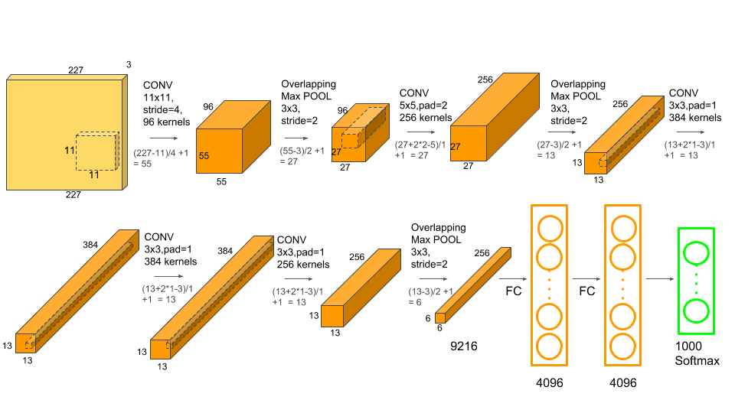
Alexnet

Slide 10
Activation function: RELU(to avoid vanishing gradient)
Dropout: used only in fully connected layers after each one
Data Augmentation: the images was flipped and rotated in different positions
Batch Normalization to avoid Covariate Shift
L2 regularization
Max Pooling

Slide 11
VGG - Visual Geometry Group at Oxford University

Slide 12
No new „block” from AlexNet
The mai difference is that in VGGNet they use 3X3 pool size filter and not of varying size
Two 3X3 filters with no pooling between them act like a 5X5 filter, three act as a 7X7. Decreases the number of training params.

Slide 13
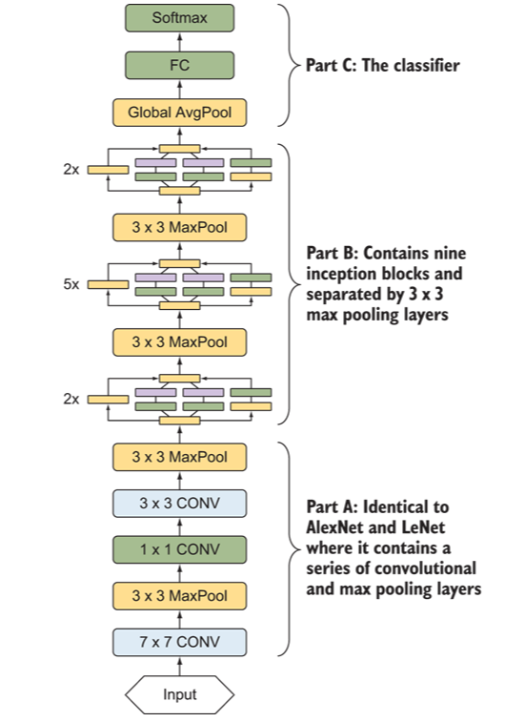
Inception/ googlenet
Is formed from multiple inception modules that contain various COV layers with different pool sizes

Slide 14
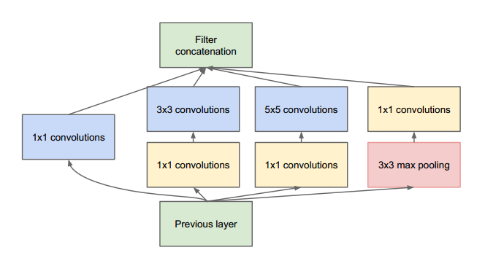
Inception module

Slide 15
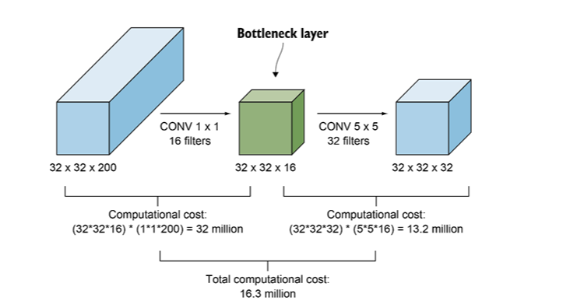
The 1X1 componenet is just for depth reduction. It will maitain the height and width of the input but will reduce the dimensionality

Slide 16
RESNET
Was the first network to test how deep can a neural network can be architected
The nouvel features were the ability to bypass the vanishing and exploding gradient by using a ”skip connection”

Slide 17
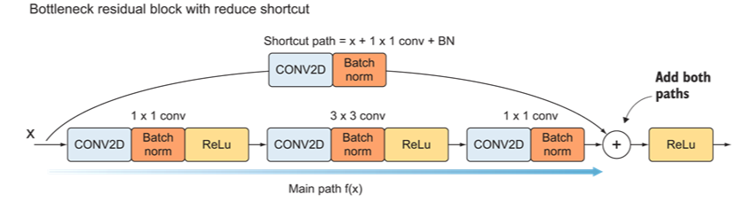
Residual block

Slide 18
